Slide 1
Welcome
To
Stress Management Workshop
Through
Sahaja Yoga
Meditation

Slide 2
Session 1 – Total 45 minute
A/V on Stress Management……… 05 min
Concept of Yoga and Health ……………….. 05 min
Self Realization – Know Your ‘Subtle Body’…… 05 min
Experience ‘Peace’ through Self Realization.. 20 min
How to practice at home / Q & A…………… 05 min
Summary (Video Interview of ‘founder’ in USA).. 05 min

Slide 3

Concept of “Yoga” and “Health”
General belief ‘yoga' might be all about exercises or asana however it is just a tip of the iceberg to achieve a good health
In ancient science like Astanga yoga (Patanjali) & Bhrugu nadi, advance step described is self-realization to reach meditation (thoughtless awareness) state, are the base to achieve Peace and Harmony to manage any kind of stress…
Harmony is not just about physical fitness but is an amalgamation of physical (body), mind, emotions and spiritual being, are the essence of ‘Sahaja Yoga’
Stress can be managed by knowing the Foundation of our being, which is present as “The Subtle body” within all of us
Body
Social
Mind
Material
Inner
Outer
Inner Harmony
Outer Balance
Harmony
Balance
Emotions
Career
Spirit
Family
Yoga also refers to balance - "inner harmony and outer balance".

Slide 4
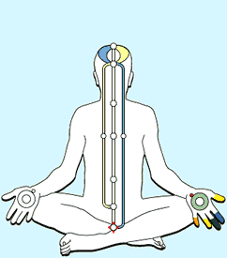
Self Realization - Know Your ‘Subtle Body’
Sahaja = Born within and Simple
Yoga = Connecting individual consciousness with the Nature also termed as ‘Self Realization’ brings emotional, physical, mental and spiritual wellbeing
Subtle body = 3 channels (nadis), 7 plexus (chakras), Living Energy (Kundilini in sanskrut)
When connected with nature, one feels peace, silence (thoughtless), joy and reduce stress
Cool/hot breeze of relaxing theta waves (vibratory awareness) can feel on finger tips or top of the head and imbalances can be diagnosed !
Nature
Right Channel
(Future, Activity & Planning)
Physical & Mental Fitness
Left Channel
(Past , Desires & Emotions)
Emotional Fitness
Centre Channel
(Present, Evolution & Joy)
Peace & Harmony
Living Energy
(Kundalini)

Slide 5
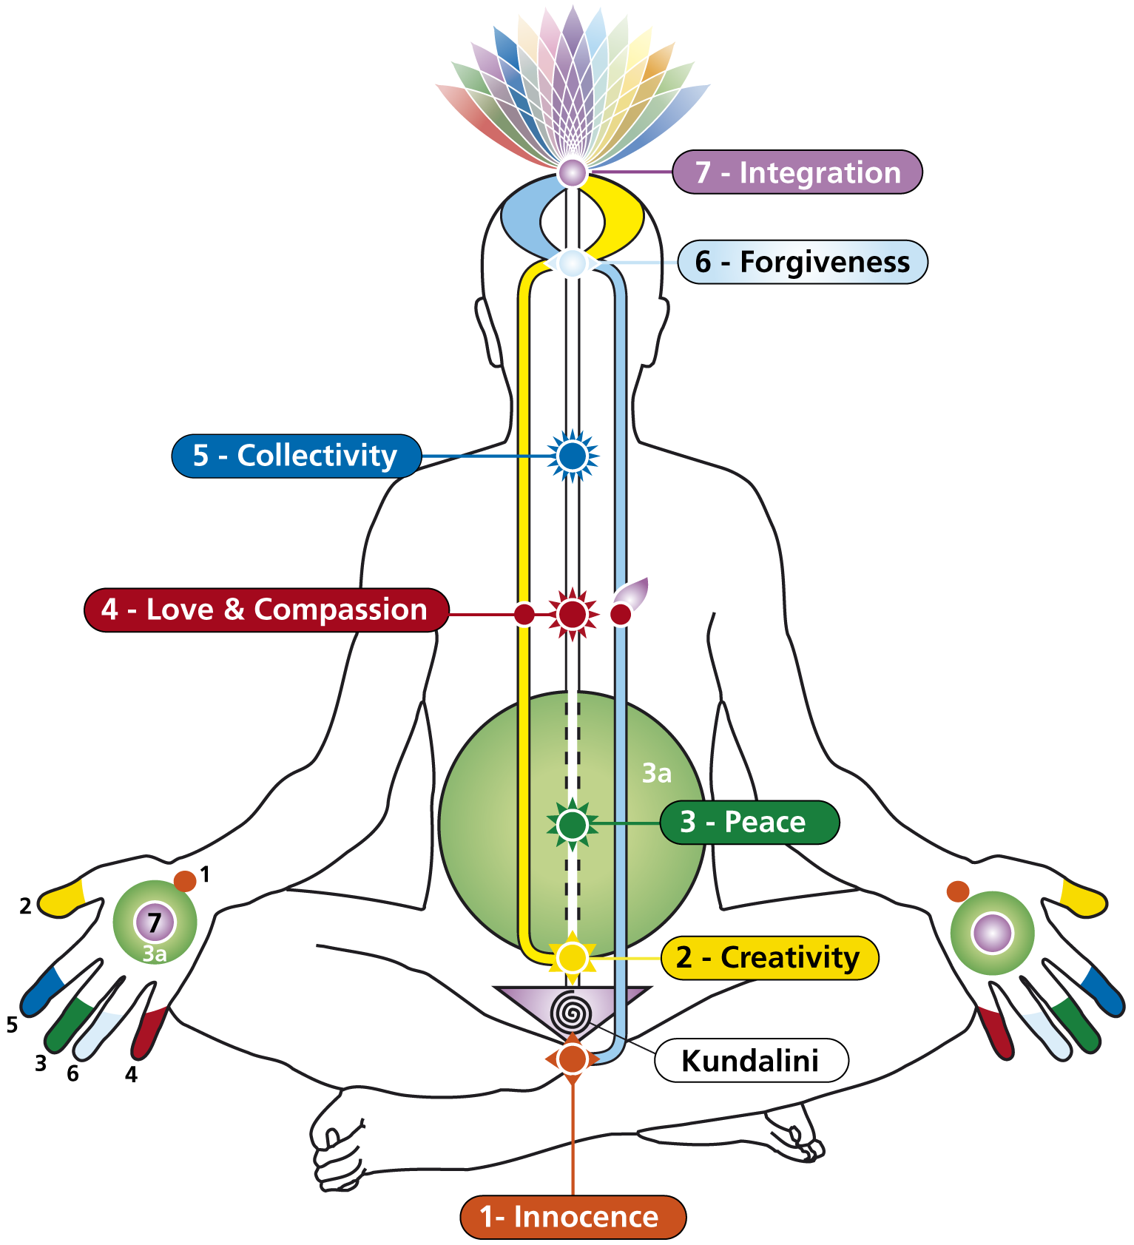

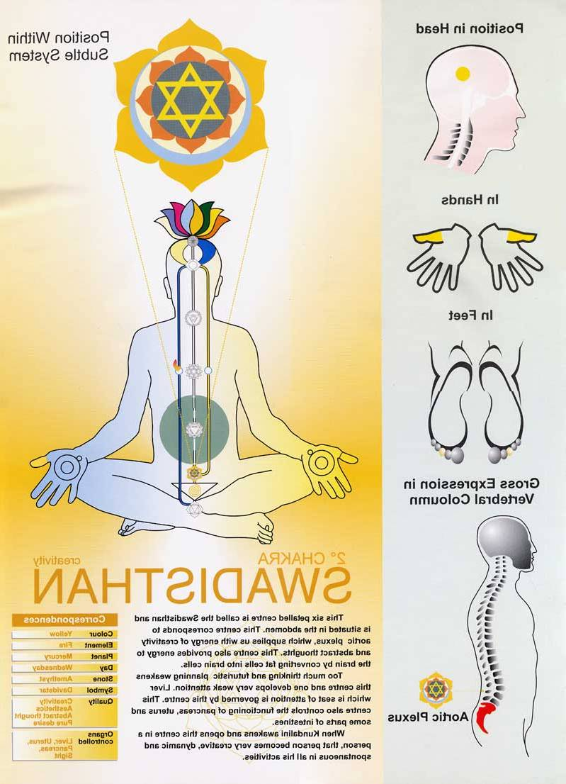
The Subtle System
Plexus / Chakra (1 to 7)
7-Limbic Area
Sahastrara
7
6-Optic Chiasma
Agnya
6
5-Cervical Plexus
5
Vishuddhi
4-Cardiac Plexus
4
Heart
3-Solar Plexus
3
Nabhi
2
2-Aortic Plexus
Swadisthana
1
1-Pelvic Plexus
Mooladhara

Slide 6
Imbalances of the subtle body corrected with
‘Cleansing Techniques’
Asana for each chakras / channels
Music/Raagas for each chakras / channels
Five Elements for chakras / channels
Affirmation in Meditation for chakras
Simple Exercise / Walking / Massage
Food –Carbohydrate vs Protein

Slide 7
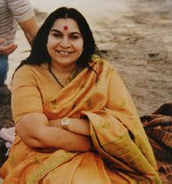
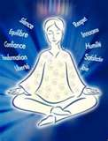
Sahaja Yoga
(About Founder)
Dr. Nirmala Devi Srivastava discovered Sahaja Yoga in 1970
Today Sahaja Yoga is practiced free of cost over 130 countries and as UNESCO peace partner
Appointed as Honorary Member of the Petrovskaya Academy of Art and Science (Russia). In the history of the Academy, only twelve people have been granted this honour, Einstein being one of them. Shri Mataji inaugurated the first International Conference on Medicine and Self-Knowledge, which became an annual event at the Academy thereafter.
She is a recipient of numerous awards and recognitions and was nominated twice for Nobel peace prize

Slide 8
Let’s Experience ‘Peace’
through
Self Realization
(1st – Sahaja Yoga Step)

Slide 9
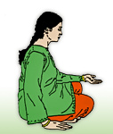
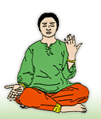
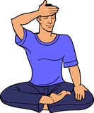
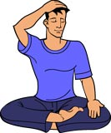
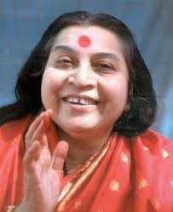
1ST & 2ND STEP- BALANCING CLEARING LEFT & RIGHT CHANNEL
Place your right palm on your lap & left palm facing sky.
Pray: Please cleanse my right channel
Place your left palm on your lap & the right palm on earth.
Pray: Please cleanse my left channel
3RD & 4TH STEP -CLEARING CROWN & LIMBIC ENERGY CENTRE
Place the centre of right palm on the top of your head and press firmly.
Pray: Please give me self realization
Place your right hand on your forehead & press tightly.
Pray - I forgive everyone including myself.
You have to develop that peace of mind within yourself by which you can become the witness of yourself first. You should be able to witness yourself and see what are the things, which are putting you down.
Notes:
9

Slide 10
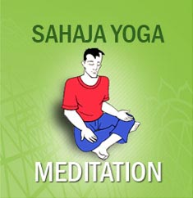

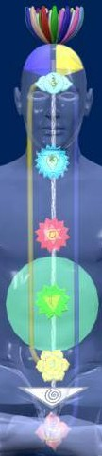
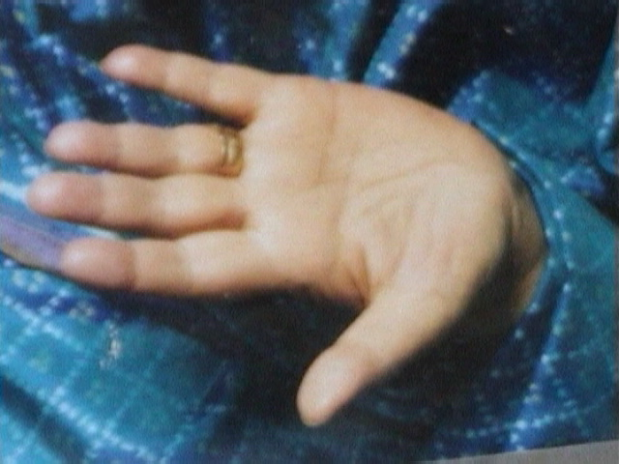
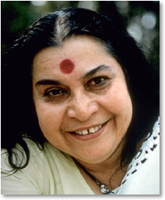
5th Step Meditation- Self Realization
Instrumental Music
Sit in meditation posture for 2-5 minutes keeping attention on the top of your head
Pray: Please give me peace & joy.
Activity of Self-diagnosis on finger tips
7
4
6
6
3a
5
7
1
3
4
5
3
3a
2
2
1
"Unless and until you know yourself, unless and until there is self knowledge - your confusion cannot disappear."
Notes:
10

Slide 11
TIPS FOR DOING AT HOME
Daily morning and evening (before sleep) 5 -10 minute meditation
Regular practise of meditation will develop self (vibratory) awareness to diagnose imbalances and cleansing techniques are applied to correct it whenever require
Weekly attending collective meditation at nearest centres or on-line mediation which is always free throughout life time globally

Slide 12
What is Next…..more weeks ?
Program | Date | Duration | Agenda | What you will take away
Session 2 | Day 2 | 1 Hr per Week or Month | Recap of Day 1 Qualities of three channels Guided meditation for balancing Interactive Session | Foundation for peace / thoughtless awareness Deep understanding of earth & ether element techniques to cleanses left side (emotions) responsible for psychosomatic diseases like lethargy, sleeping disorders or depressions and right side (mental & physical) responsible for high BP, headaches, heart attack etc.
Session 3 | Day 3 | 1 Hr per Week or Month | Recap of Day 1 & 2 Qualities of first three Chakras Guided Meditation for first three chakras Q&A, Feedback | Understanding of first three chakras' qualities responsible for prostate gland, kidney, Liver & stomach problem etc. Cleansing techniques for first three chakras (five elements/asanas )
Session 4 | Day 4 | 1 Hr per Week or Month | Recap of Day 1,2,3 Qualities of last four Chakras Guided Meditation for last four chakras Guidance for future Q&A, Feedback | Understanding of last four chakras' qualities responsible for heart problem, ENT, brain, spondylosis etc. Cleansing techniques for last four chakras (five elements, breathing etc.)

Slide 13
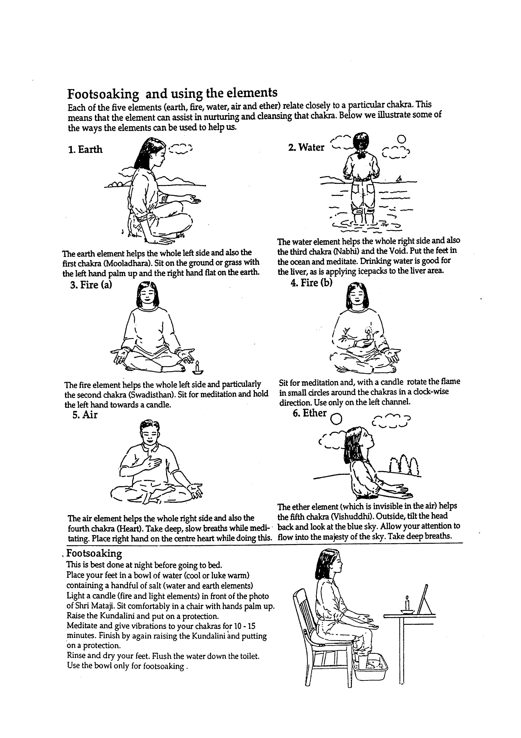
Are you gear up to learn five elements techniques !
Each of the five elements (earth, fire, water, air and ether) relate closely to a particular chakra of the subtle system. This means that the element can assist in nurturing and cleansing that chakra. Below we illustrate some of the ways the elements may be used to help the subtle system. Remember to use moderation, don’t be rigid with any techniques. See what works for you - eg if you can’t sit on the ground, use a chair.
1. Earth
The Earth elements helps the whole left side and also the first chakra (Mooladhara). Sit on the ground or grass, with left hand palm up and the right hand flat on the earth.
2. Water
The Water element helps the whole right side and also the third chakra (Nabhi) and the Void. Put the feet in the ocean and meditate. Drinking water and applying an icepack to the liver area may help in cooling the right side.
3. Fire (a)
The Fire element helps the whole left side and particularly the second chakra (Swadisthan).
To clear the left side, sit for meditation and hold the left hand towards a candle. Always use care not to have candles too close.
4. Fire (b)
To clear chakras on the left side, sit for meditation and with a candle carefully rotate the flame in small circles around the chakra in a clock-wise direction. Use candles only on the chakras on the left channel.
5. Air
The Air element helps the whole right side and also the fourth chakra (Heart). Pay attention to your breathing, gently taking a few deep breaths. Place right hand on the centre heart while doing this.
6. Ether
The Ether element (which is invisible in the air) helps the fifth chakra (Visshuddhi). Outside, tilt the head back and look at the blue sky. Allow your attention to flow into the majesty of the sky and take some deep breaths.

Slide 14
Going Further
Send email if you wish to know nearest free weekly centres and literature to practice at home
info@sahajayogamumbai.org
  www.freemeditation.com, www.sahajayogamumbai.org
Thank You

