Slide 1
Welcome
To
Stress Management Workshop
Through
Sahaja Yoga
Meditation
Session 3

Slide 2
Session 3 – Total 45 minute
Recap….Self Realization & Balancing .. 05 min
Qualities & Cleansing of first three chakras…… 05 min
Experience the peace through cleansing chakras.... 20 min
How to practice at home / Q & A…………… 05 min
Summary (Video of Founder).. 10 min

Slide 3
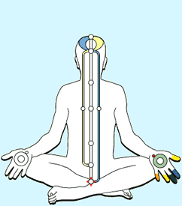
Self Realization - Know Your ‘Subtle Body’
Sahaja = Born within and Simple
Yoga = Connecting individual consciousness with the Nature also termed as ‘Self Realization’ brings emotional, physical, mental and spiritual wellbeing
Subtle body = 3 channels (nadis), 7 plexus (chakras), Living Energy (Kundilini in sanskrut)
When connected with nature, one feels peace, silence (thoughtless), joy and reduce stress
Cool/hot breeze of relaxing theta waves (vibratory awareness) can feel on finger tips or top of the head and imbalances can be diagnosed !
Nature
Right Channel
(Future, Activity & Planning)
Physical & Mental Fitness
Left Channel
(Past , Desires & Emotions)
Emotional Fitness
Centre Channel
(Present, Evolution & Joy)
Peace & Harmony
Living Energy
(Kundalini)

Slide 4
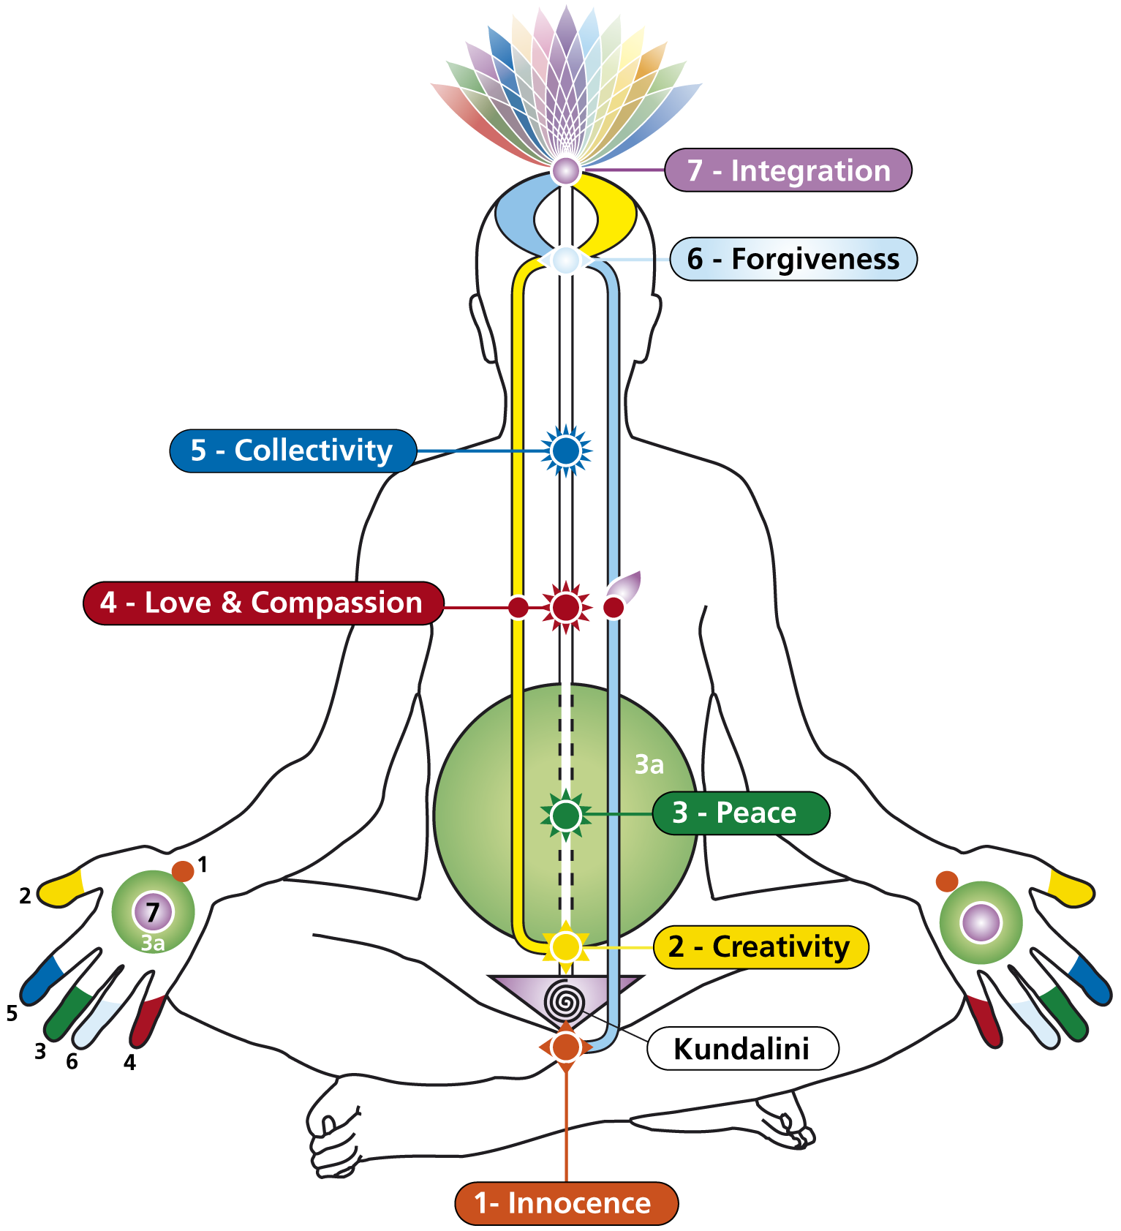
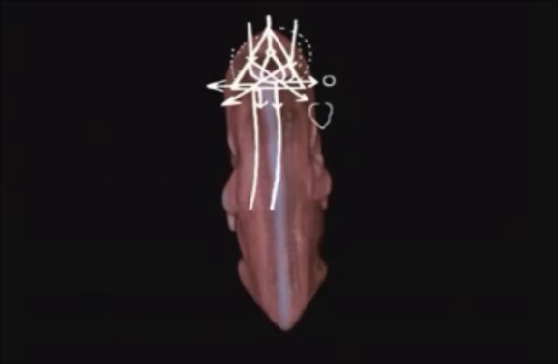

The Subtle System
(First thee chakras are foundation of Health)
Pingala Nadi
Right Sympathetic Channel
Ida Nadi
Left Sympathetic Channel
Sushmana Nadi
Central Para-
Sympathetic Channel
2
5
3
6
4
Balance = Health
Imbalance of Sympathetic channels causes Stress and Diseases

Slide 5
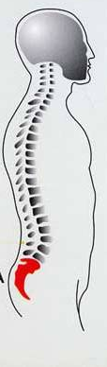
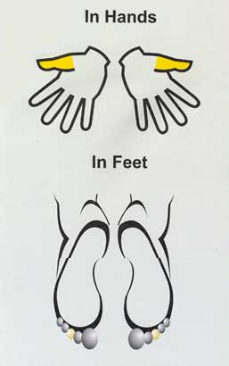
1. Mooladhara Chakra
In Hands
In Feet
Pelvic
Plexus

Slide 6
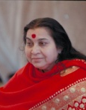
1.Mooladhara Chakra
Colour, Element | Coral red, Earth
Planet, Day, Stone | Mars, Tuesday, Coral
Instrument, Raga | Shehnai, Shayam kalyani
Quality | Innocence, Wisdom, Chastity, Spontaneity, Memory, Discretion
Organs | Reproductive & excretory organs
Diseases | Aids, Piles, Sexual Diseases
Region | Australia (Uluru)
“Mother Earth is the one who is symbolised
within us as the Mooladhara.”

Slide 7
2. Swadisthana Chakra
In Hands
In Feet
Aortic
Plexus

Slide 8

2. Swadisthana Chakra
Colour, Element | Yellow, Fire
Planet, Day | Mercury, Wednesday
Stone | Amethyst
Quality | Pure Knowledge, Aesthetics, Creativity, Pure attention, Organizing & Planning,
Organs | Liver, Kidney, Uterus, Pancreas,
Diseases | Diabetes, Kidney troubles, Constipation,
Region | France, Africa, Germany, Spain
“To satisfy Swadisthan, you have to take to silence. You have to take to quietude and look at yourself. What is bothering you, what is troubling you, what gives you ideas and thoughts is Swadisthan.”

Slide 9
3. Nabhi Chakra
In Hands
In Feet
Solar
Plexus

Slide 10
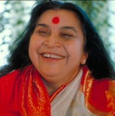
3. Nabhi Chakra
Colour, Element | Green, Water
Planet, Day | Jupiter, Thursday
Stone | Emerald
Quality | Generosity, Satisfaction, Caring, Dignified, Financially stability, Family Harmony,
Organs | Stomach, Intestines, Liver, Spleen
Diseases | Acidity, Diarrhea, Gastritis, Constipation,
Region | Europe (Itali, Austria,Greece)
“If you are extremely generous, greed will run away.”

Slide 11
3a. Void (combination Swadisthana & Nahbi)
In Hands
In Feet
Solar
Plexus

Slide 12
3a. Void (combination Swadisthana & Nahbi)
Colour, Element | Green, Ocean
Planet, Day | Jupiter, Thursday
Quality | Leadership, Ethical, Transparent, Patience, Self motivated, Visionary, Righteous behavior
Diseases | Cancer, Dialysis,
Organs | Abdominal organs
“Everything is within you. As soon as the light
comes, you can see everything.”

Slide 13
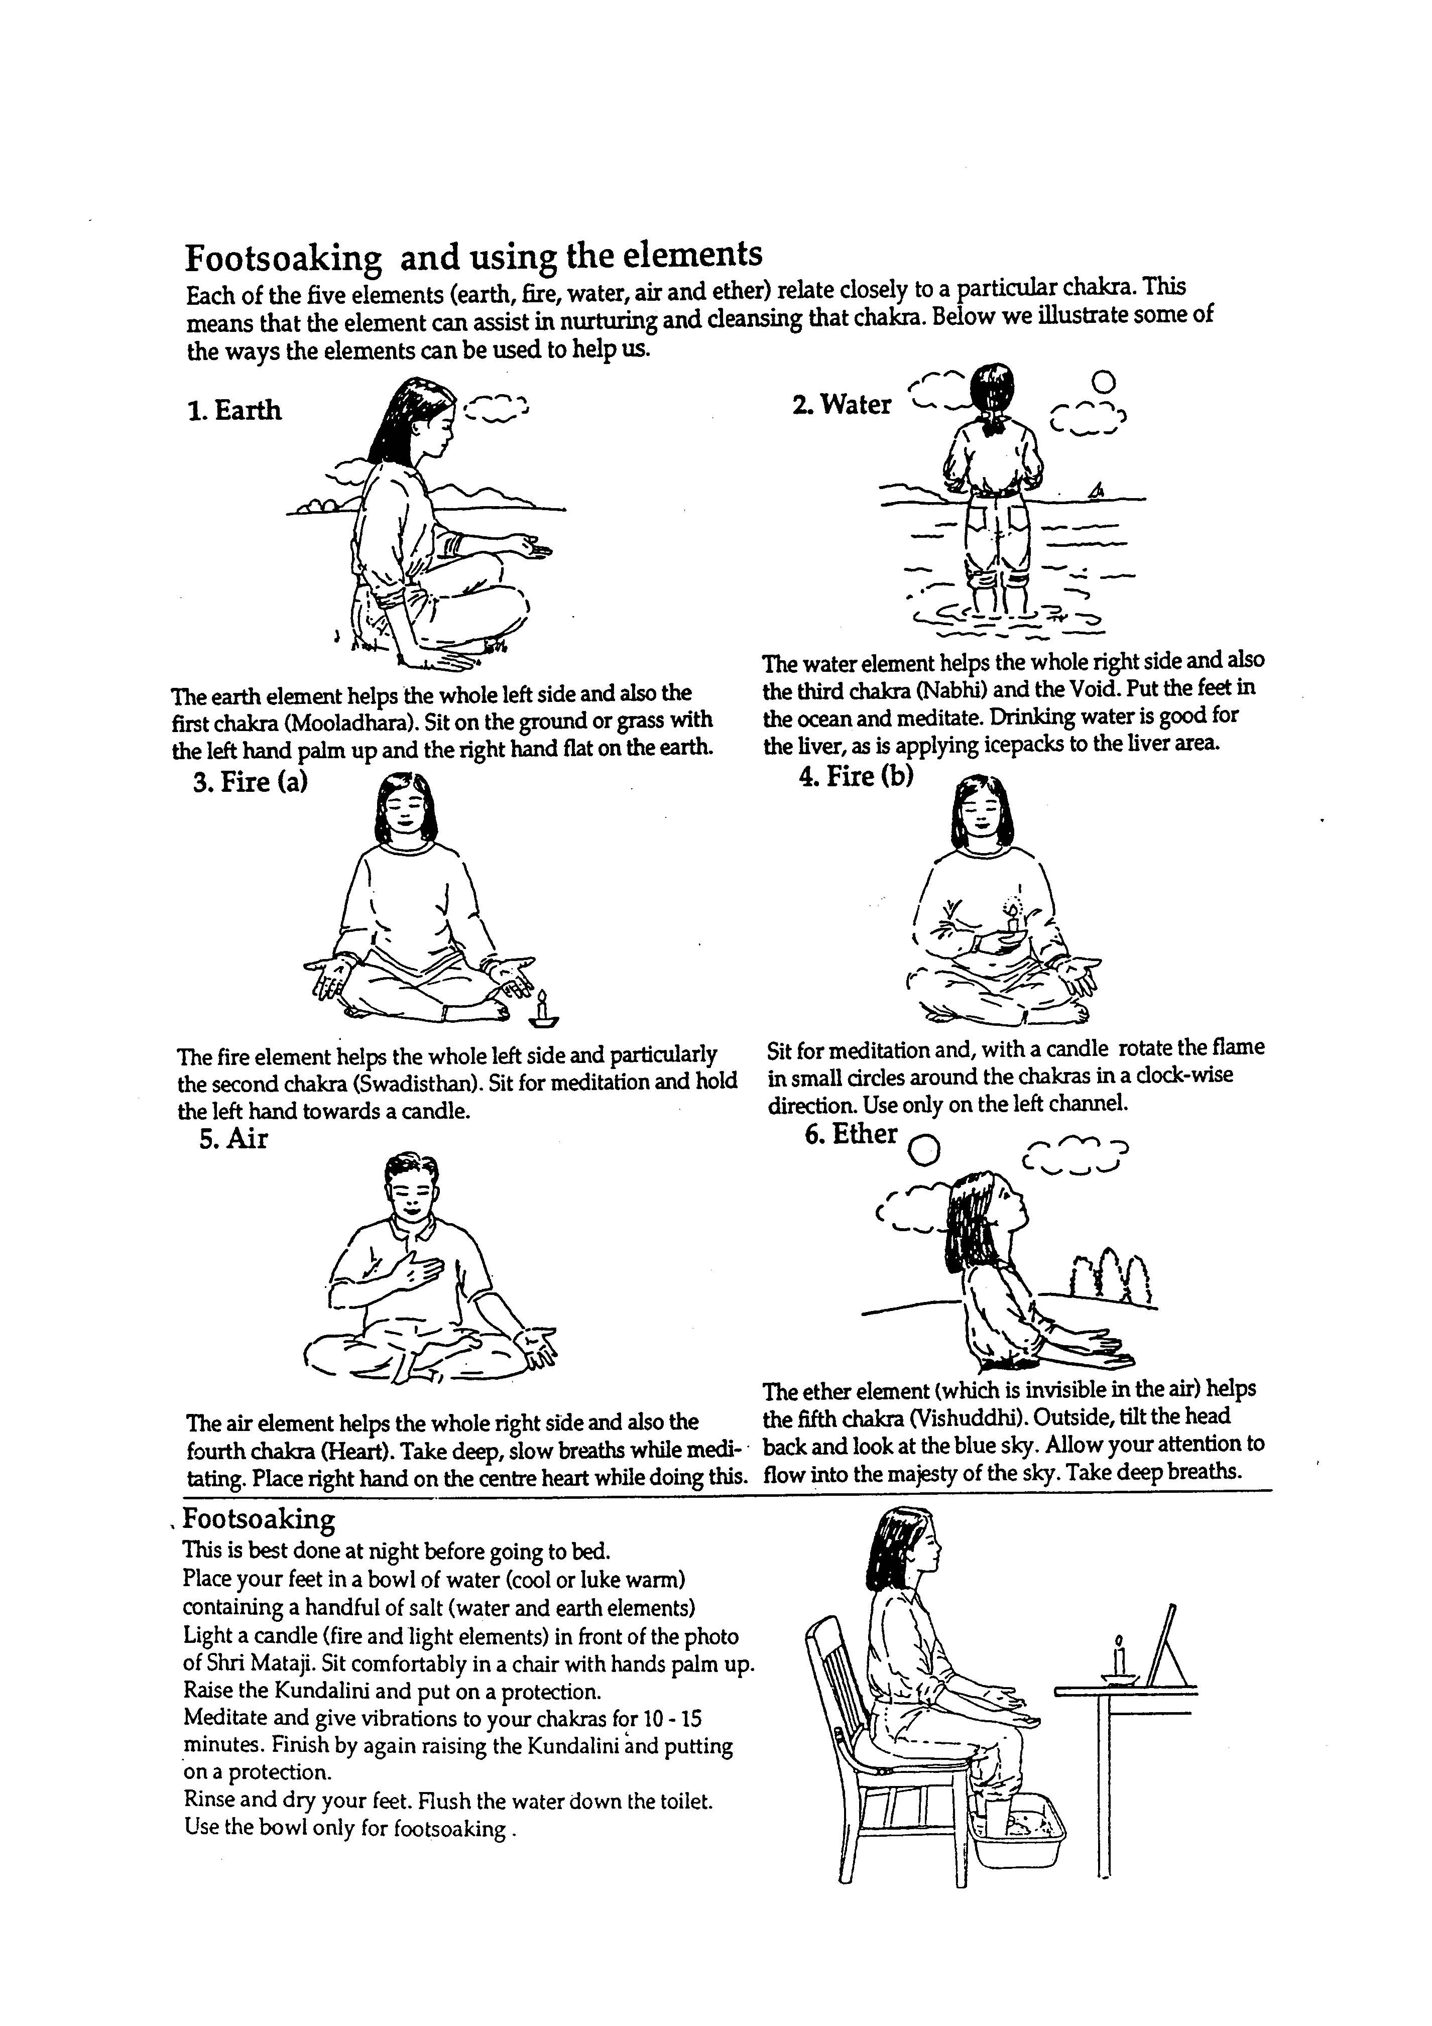

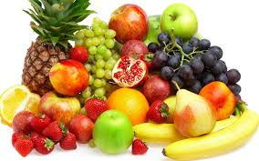
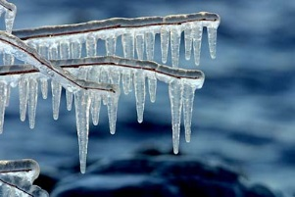
BALANCING TECHNIQUES FOR
FIRST THREE CHAKRAS
1. Earth
(1st Mooladhar)
The Earth elements helps the whole left side and also the first chakra (Mooladhara).
Sit on the ground or grass, with left hand palm up and the right hand flat on the earth.
Put right hand on heart
3. Water
(3rd Nabhi & Void )
The Water element helps the whole right side and also the third chakra (Nabhi) and the Void.
Put the feet in the ocean and meditate.
.
2. Fire
(2nd Left Swadisthan )
The Fire element helps the whole left side and particularly the second chakra (Swadisthan).
To clear the left side, sit for meditation and hold the left hand towards a candle. Always use care not to have candles too close.
4. Food/ Lifestyle
Fruits very good for Nabhi
Liver Diet includes kokum/ Rose/Sugarcane Juice, Muli etc.
Junk / Oily Food, Alcohol harms liver
3. Water
(3rd Right Swadisthan )
Applying an icepack to the liver area (right side) may help in cooling the right side.
5. Exercise / Massage / Asana
Butterfly Assan for Mooladhar
Pawanamukti type Assan for Swadishthan
Walking barefoot on Mother Earth

Slide 14
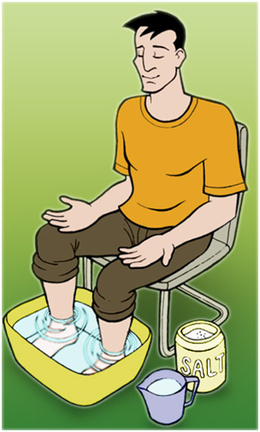
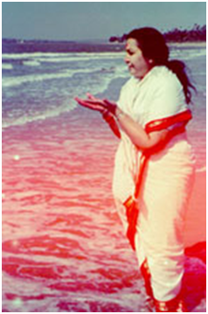
Using ocean elements – foot soak
A powerful technique
to clean subtle system
Use 5 elements
  Air
  Earth
  Water
  Fire
  Ether (sky)
Ideal in the Ocean
Just before going to sleep – 5-10 mins

Slide 15

Ice pack on liver
Effects
Cools down the liver
  (and reduces activity of the
  right channel)
helps stop thinking and meditate
To be applied only on the right side

Slide 16
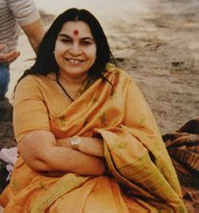
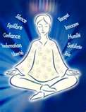
Sahaja Yoga
(About Founder)
Dr. Nirmala Devi Srivastava discovered Sahaja Yoga in 1970
Today Sahaja Yoga is practiced free of cost over 130 countries and as UNESCO peace partner
Appointed as Honorary Member of the Petrovskaya Academy of Art and Science (Russia). In the history of the Academy, only twelve people have been granted this honour, Einstein being one of them. Shri Mataji inaugurated the first International Conference on Medicine and Self-Knowledge, which became an annual event at the Academy thereafter.
She is a recipient of numerous awards and recognitions and was nominated twice for Nobel peace prize

Slide 17
Let’s Experience ‘Peace’
through
(Self Realization
and Cleansing Chakras)

Slide 18
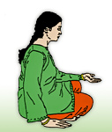
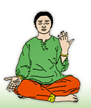
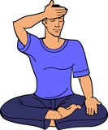
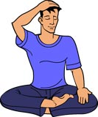
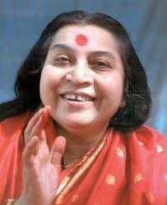
1ST & 2ND STEP- BALANCING CLEARING LEFT & RIGHT CHANNEL
Place your right palm on your lap & left palm facing sky.
Pray: Please cleanse my right channel
Place your left palm on your lap & the right palm on earth.
Pray: Please cleanse my left channel
3RD & 4TH STEP -CLEARING CROWN & LIMBIC ENERGY CENTRE
Place the centre of right palm on the top of your head and press firmly.
Pray: Please give me self realization
Place your right hand on your forehead & press tightly.
Pray - I forgive everyone including myself.
Supposing the Mother Earth was very hot like the sun, there would have been no growth, or it was cold like moon, there would have been no growth. It had to come to the centre where it had both the things in proper proportions to grow. In the same way a human being has to work out that you keep a moderation and a balance and understand not to go to extremes of anything.
Notes:
18

Slide 19
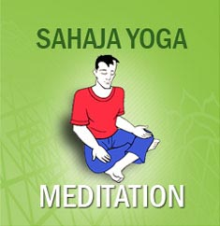

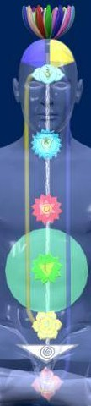
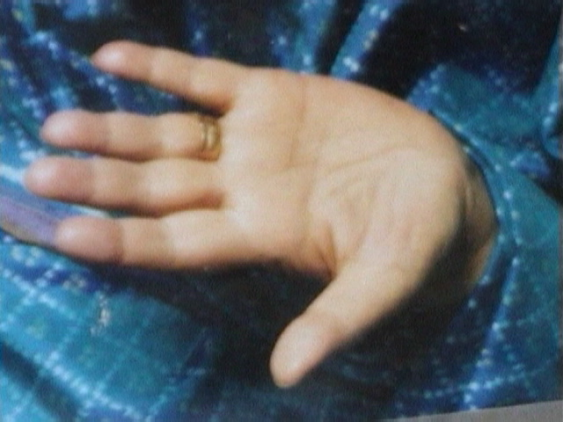
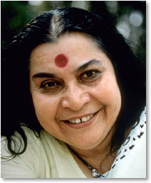
5th Step Meditation- Self Realization
Instrumental Music
Sit in meditation posture for 2-5 minutes keeping attention on the top of your head
Pray: Please give me peace & joy.
Activity of Self-diagnosis on finger tips
7
4
6
6
3a
5
7
1
3
4
5
3
3a
2
2
1
"Unless and until you know yourself, unless and until there is self knowledge - your confusion cannot disappear."
Notes:
19

Slide 20
TIPS FOR DOING AT HOME
Daily morning 5 minute balancing techniques followed by 5 min meditation.
Daily 10 minute “water technique” before sleeping in night followed by 5 min meditation ,
Ice Pack / Fire element techniques whenever needed
Weekly attending collective meditation at nearest centres or on-line mediation which is always free throughout life time globally

Slide 21
What is Next…..more weeks ?
Program | Date | Duration | Agenda | What you will take away
Session 2 | Day 2 | 1 Hr per Week or Month | Recap of Day 1 Qualities of three channels Guided meditation for balancing Interactive Session | Foundation for peace / thoughtless awareness Deep understanding of earth & ether element techniques to cleanses left side (emotions) responsible for psychosomatic diseases like lethargy, sleeping disorders or depressions and right side (mental & physical) responsible for high BP, headaches, heart attack etc.
Session 3 | Day 3 | 1 Hr per Week or Month | Recap of Day 1 & 2 Qualities of first three Chakras Guided Meditation for first three chakras Q&A, Feedback | Understanding of first three chakras' qualities responsible for prostate gland, kidney, Liver & stomach problem etc. Cleansing techniques for first three chakras (five elements/asanas )
Session 4 | Day 4 | 1 Hr per Week or Month | Recap of Day 1,2,3 Qualities of last four Chakras Guided Meditation for last four chakras Guidance for future Q&A, Feedback | Understanding of last four chakras' qualities responsible for heart problem, ENT, brain, spondylosis etc. Cleansing techniques for last four chakras (five elements, breathing etc.)

Slide 22
Going Further
Send email if you wish to know nearest free weekly centres and literature to practice at home
info@sahajayogamumbai.org
  www.freemeditation.com, www.sahajayogamumbai.org
Thank You

